Slide 1
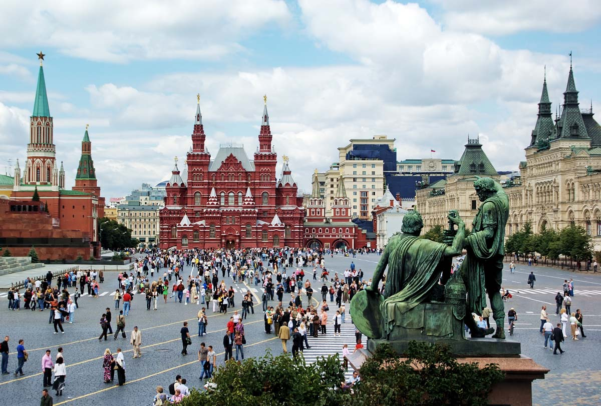
Red Square

Slide 2
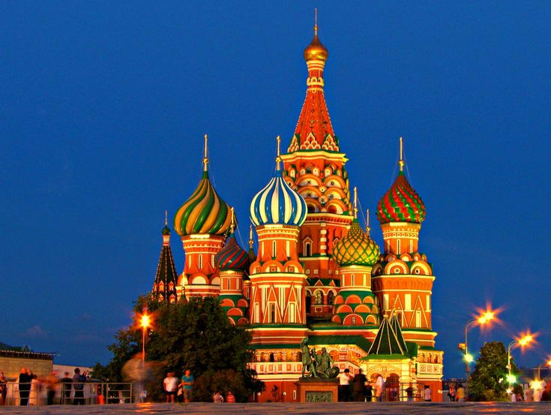
St Basil’s Cathedral
[ˈbeizilz]

Slide 3
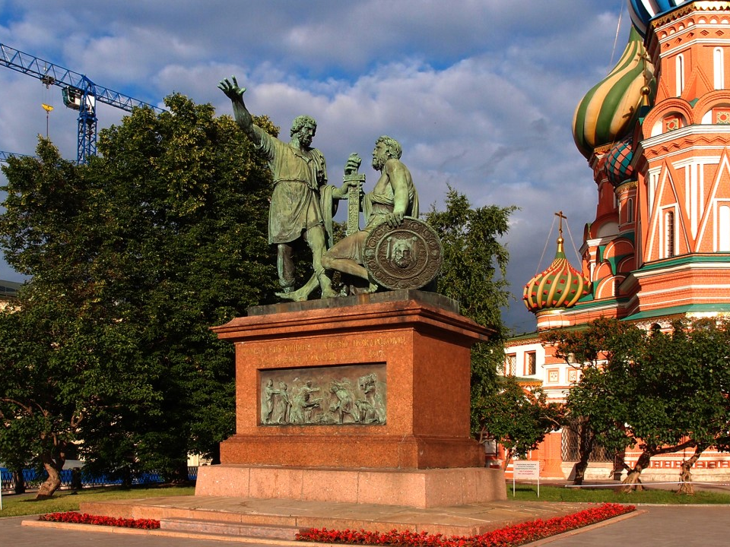
The Monument to Minin and Pozharskiy

Slide 4
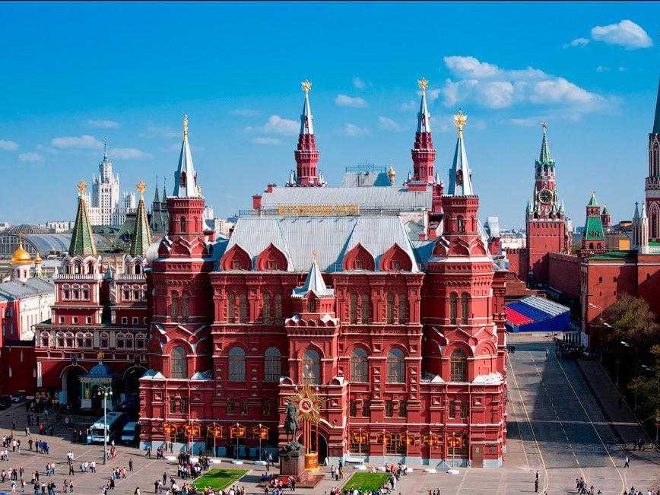
The History Museum

Slide 5
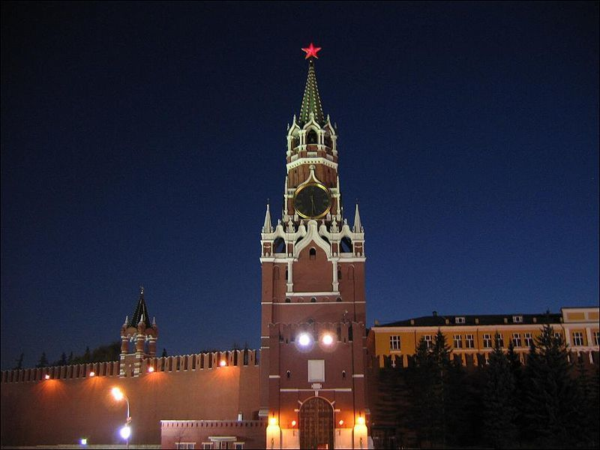
Spasskaya Tower

Slide 6
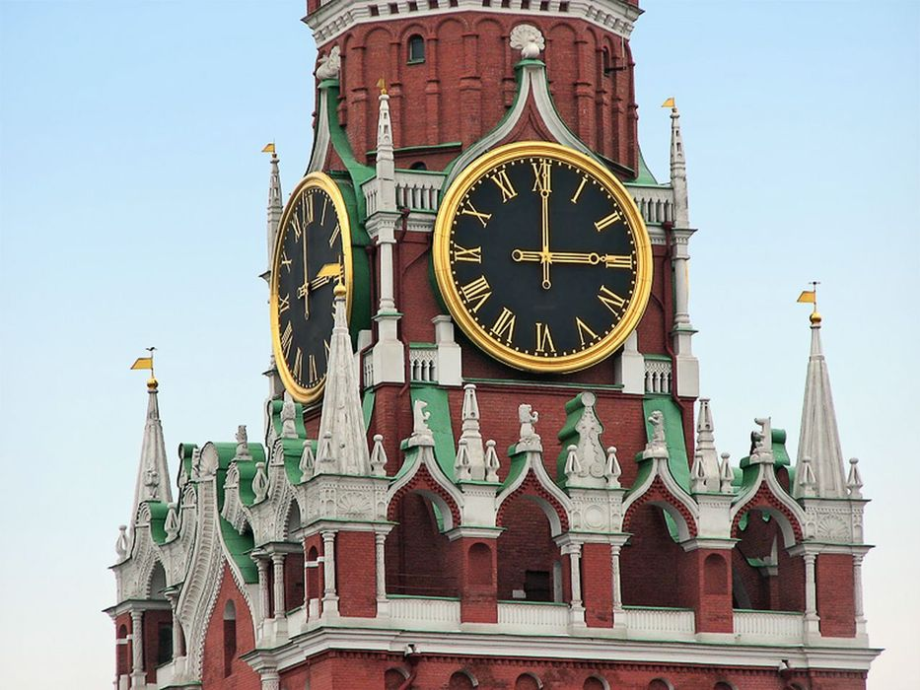
The Kremlin Clock

Slide 7
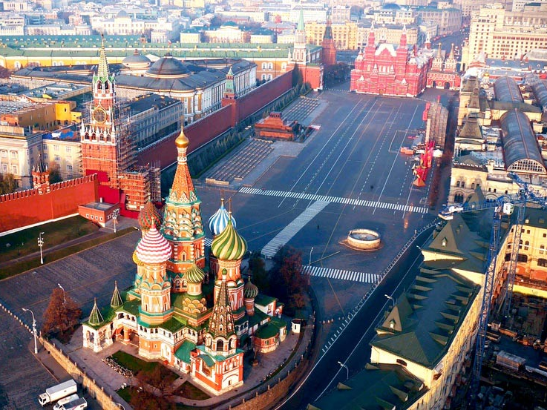
Red Square

