Slide 1
New Words

Slide 2
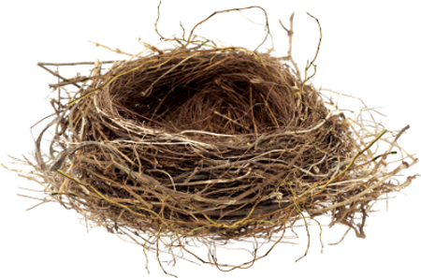

Slide 3
nest
[nest]

Slide 4
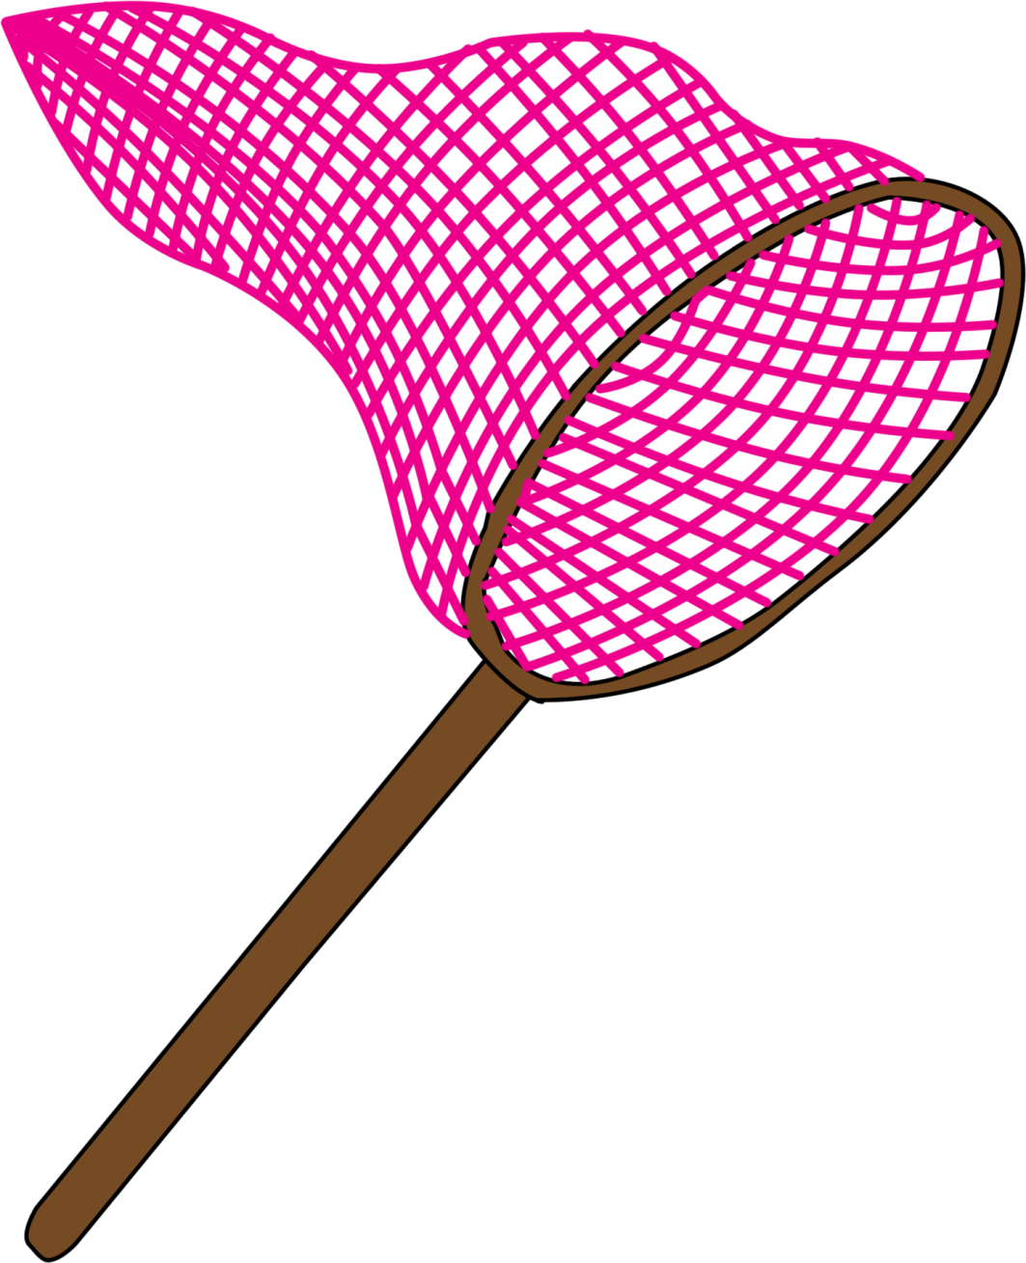

Slide 5
net
[net]

Slide 7
ten
[ten]

Slide 8
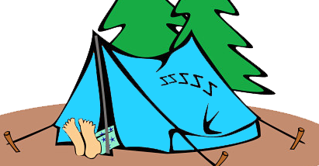

Slide 9
tent
[tent]

Slide 10
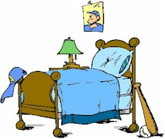

Slide 11
bed
[bed]

Slide 13
bell
[bel]

Slide 14
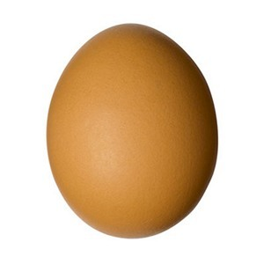

Slide 15
egg
[eg]

Slide 16
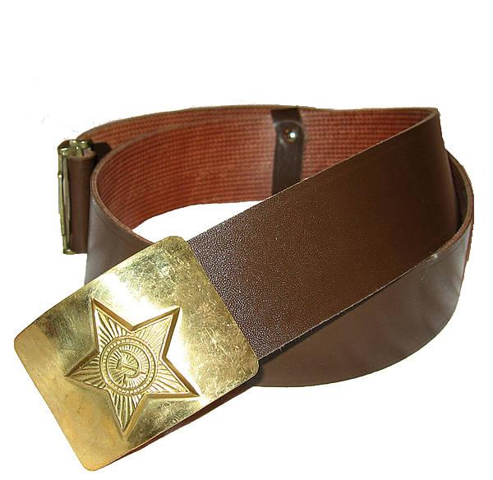

Slide 17
belt
[belt]

Slide 18
Goodbye!

